Slide 1
Home Network & Heatmap Presentation
Samuel Hendrix
MIS 4123

Slide 2
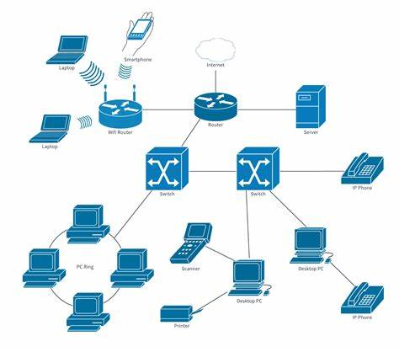
Home network Diagram

Slide 3
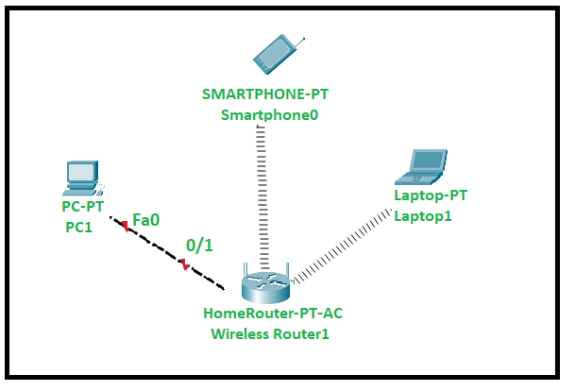
Packet tracer Diagram

Slide 4
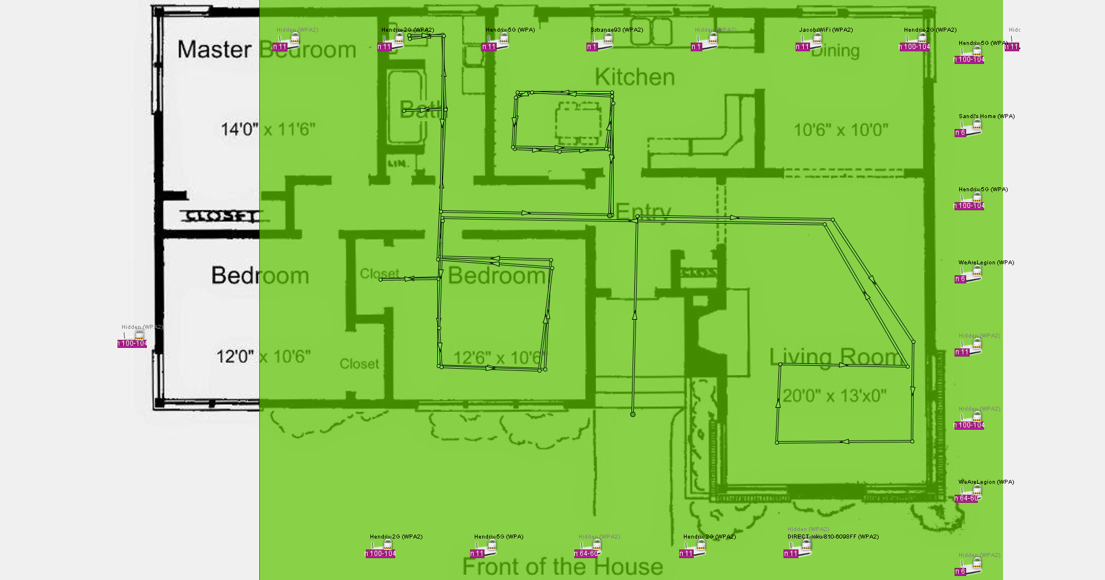
Heat map

Slide 5
Final Overview
Good connection throughout the house
Weakest in the master and guest bedroom
Could move the router to the center of the house to balance the connection

Slide 6
Thank you

